Slide 1
World History Final Exam Review
PowerPoint 1
Early Humans, Early River Civilizations, Early Empires, World Religions, and Types of Government

Slide 2
Early Humans
We learn about early humans through archaeology and anthropology since they left no written records (prehistory).
Carbon dating can be used to date fossils (once living; can be human remains, plant or animal remains)
Stratigraphy can estimate date of artifacts (human-made items)
Hominid: humanlike creature that walked upright
The earliest lived in Africa and adapted overtime
“Out of Africa Theory” or Replacement Theory states that these early humans began to leave Africa and spread to other parts of the world between 150,000 and 200,000 years ago.

Slide 3
Out of Africa Theory

Slide 4
Paleolithic Age
Designates a period of early human history in which humans developed simple stone tools
“Old Stone Age”
The people of this period were nomadic
Nomad: moved from place to place following their food sources (no permanent housing or settlements)
Hunter-gatherer lifestyle
Small groups
Developed the use of fire
Provided warmth, protection from wild animals, and cooked food
First examples of cave art

Slide 5
Neolithic Revolution/Neolithic Age
Major turning point in human history=development of farming
Shift from hunting and gathering to growing their own food
Occurred from 8000 to 4000 BC at different places around the world
Major Impacts:
Domestication of animals
People began to settle into permanent villages/towns
Separations of labor
Artisans—skilled laborers who made tools
Trade began (merchants)
Use of new metals (bronze then iron)
Emergence of civilizations (complex culture in which large numbers of human beings share common elements such as government, religion, writing, art, etc.)

Slide 6
Early Humans Recap
Cause | Effect
Early humans learn to make tools and fire | Tools make hunting easier Early humans become more efficient hunters Cooked food improved nutrition Warmth available in cooler climates
After the Ice Age ends, temperatures rise and humans begin to practice systematic agriculture (keeping of animals and growing of food on a regular basis). | Steady food supply leads humans to settle in farming villages Surplus food is stored Villagers and food supply must be protected
Civilizations begin to develop in river valleys in Mesopotamia, Egypt, India, and China | Governments develop to organize and protect cities. Not all villagers are needed for farming, so some become artisans, government workers, priests, artists, and scribes. Division of labor leads to social structures. Surplus food and products are traded with other settlements.

Slide 7
Early Humans Test Practice Answer without going back into notes or looking up anything to test your understanding. Have your work from Friday out on your desk for me to check!
Archaeologists study ___, or objects made by humans.
Rivers
Animals
Artifacts
Oceans
The keeping of animals and the growing of food on a regular basis is known as ____.
Systematic agriculture
Neolithic agriculture
Paleolithic agriculture
Domesticated agriculture

Slide 8
_____ skilled workers who made products such as weapons and jewelry.
Farmers
Anthropologists
Artisans
Priests
How did early humans adapt in order to survive?
Following animal migrations
Painting cave art
Living in isolation
Keeping records

Slide 9
During which age did the agricultural revolution lead to the development of civilization?
Paleolithic
Ice
Neolithic
Bronze
Where did many early river civilizations develop?
Deserts
River valleys
Mountain valleys
Forests

Slide 10
Why were Paleolithic people nomads?
Fear of enemies kept them moving.
Rival groups drove each other out of settled areas.
They had to follow animal migrations.
They had to look for more habitable climates.
Into which areas did early humans spread most recently?
Asia
Europe
Australia
North and South America

Slide 11
Why was writing important to many early governments?
To describe court life
To express individual beliefs
To keep records
To write songs
The first examples of technological innovation, such as the making of stone tools, occurred during which of the following time periods?
Neolithic Age
Paleolithic Age
Nomadic Age
Bronze Age

Slide 12
Which of the following is not associated with the people of the Neolithic Age?
The development of systematic agriculture.
The domestication of animals.
The development of simple stone tools.
The development of permanent settlements.
What term best describes a large number of people who share many common social, religious, and governmental elements and live in and around a city or cities?
Culture
Civilization
Social structure
Organized community

Slide 13
All of the following statements are true regarding archaeological research except which one?
They learn about past societies by examining what early humans left behind.
They study artifacts, which are human fossils.
They developed scientific methods for research.
Human culture prior to the advent of writing can be explored through archaeology.
What was the most important use for writing in early history?
Correspondence between people
Self-expression through poetry and fiction
Accurate record keeping
Use in schools

Slide 14
ANSWERS
C
A
C
A
C
B
C
D
C
B
C
B
B
C
You should have gotten 12 questions correct to make an 85% mastery score on this assessment.
If you didn’t, you need to review this topic!
Early Humans (Chap 1 in blue textbook)

Slide 15
Early River Civilizations
Early River Civilizations emerged among river valleys in Mesopotamia, Egypt, India, and China.
Characteristics of a civilization:
Organized towns/cities
Government
Religion
Social structure/hierarchy
Writing
Art

Slide 16
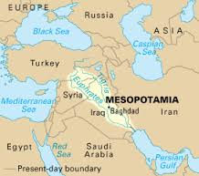
Mesopotamia
Modern-day Iraq, Fertile Crescent, “land between the two rivers”
Little rainfall, unpredictable flooding
Use of irrigation and drainage
Rivers: Tigris-Euphrates
First civilization=Sumerians
Known for bronze trade
Cuneiform writing
Invented the wheel and sundial
Advanced in math and astronomy
Polytheistic religion
Theocracy=government of divine authority
Sun-dried brick buildings/homes and walled cities
Ziggurat=temple, stepped tower located in the middle of cities
Babylonians eventually took over the area
Hammurabi’s Code: earliest known law code known for strict justice
Laws published on clay tablets in city centers so that people would be aware of the laws and punishments
“eye for an eye”

Slide 17
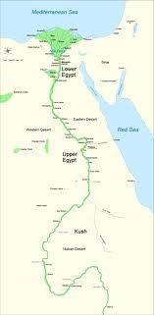
Ancient Egypt
River: Nile (longest river in the world)
Regular annual flooding
Irrigation techniques
Natural barriers: desert (Sahara), Red Sea, water rapids, and the Mediterranean Sea
Nile River Delta (triangle) and part of the Fertile Crescent
Polytheistic religion (viewed river and other natural elements as gods)
Dynasties: family of rulers whose right based within the family
Pharaohs
Mummification and pyramids show belief in afterlife
Hieroglyphic writing (religious) and hieratic script (everyday)

Slide 18
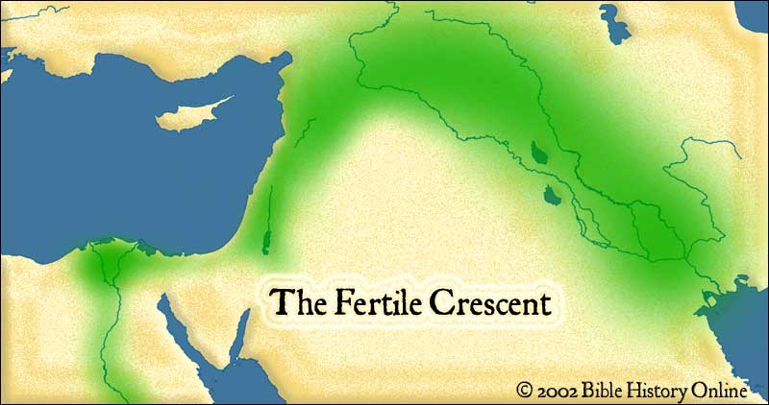
Made up of Mesopotamia and Egypt
Fertile area allowing for farming surrounded predominantly by desert lands

Slide 19
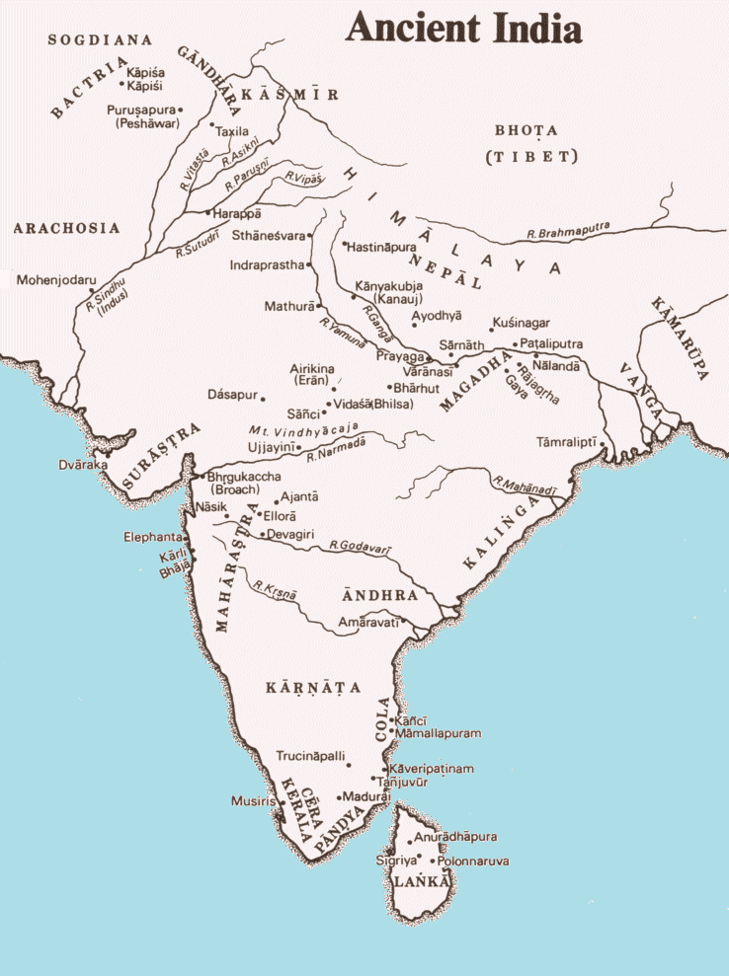
Ancient India
Indus River Valley and Ganges River
Himalayan mountains, deserts
Monsoons (winds bringing in rainfall) led to dangerous flooding
Mohenjo-Daro and Harappa are two of the oldest civilizations in Ancient India
Very little written record known before the Aryans (Europeans) who moved into the area.
Indians adopted their writing (sanskrit)
Rigid class system (caste system)
Hinduism
Reincarnation
Karma and dharma
Buddhism
Buddha or Siddhartha
Nirvana, 4 Noble Truths, and the 8 Fold Path
Development of the Silk Road helped trade in India (this route went from China to the Roman Empire)

Slide 20
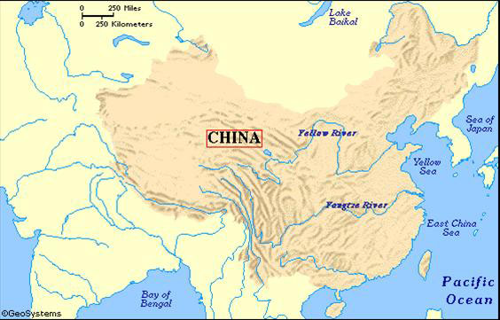
Ancient China
Major Rivers: Huang He (Yellow) and Chang Jiang
Mountains and deserts serve as natural barriers, but the north was open to invasion
Qin Dynasty eventually built the Great Wall to protect China’s northern border from invaders
Mandate of Heaven aka Dynastic Cycle
The rulers were chosen by the heavens (king was the link between heaven and earth)
First adopted by the Zhou
Rulers should change in times of turmoil or unrest
Religion/Philosophy: Confucianism emerged
Some practiced ancestor worship
First civil service exams (aka Rule of Merit) to prove an applicant was worthy of a job before hire
Chinese are credited with the the invention of silk, porcelain, and paper among other things…

Slide 21
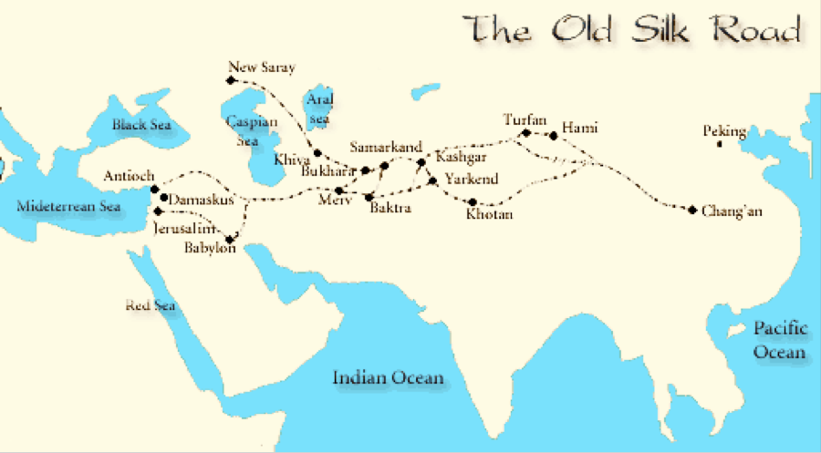
The Silk Road
Trade named for the luxury good silk which was made exclusively in China in the ancient period.
Other luxury goods were also sold along the trade route that stretched from China to the Roman Empire crossing several different empires in between.
Some towns/cities emerged along the Silk Road due to trade and traffic through the areas.
Travel on the Silk Road was very dangerous, but very profitable if someone completed the route successfully. Therefore, some merchants were willing to take risk.

Slide 22
At the same time…
Phoenicians developed an empire in the modern-day Palestine/Israel
Known for their alphabet! Influenced the Greeks, Romans, and even our modern alphabet!
Great sea traders due to location along the Mediterranean Sea (traded primarily to the west—Africa and Europe—due to their location on the coast)
Judaism was founded in Israel
First followers known as the Israelites
Monotheistic religion
One god=Yahweh
Religious text=Torah

Slide 23
Early River Recap
Egyptians received fertile soil from the floodwaters of the Nile for farming.
The Phoenicians set up a trading empire and colonies along the Mediterranean Sea.
Mesopotamians created irrigation and flood control systems.
Mesopotamians and Egyptians were both polytheistic and believed their rulers derived their powers from the gods.
Israelites were monotheistic and believed God communicated to them through prophets.
Mesopotamians established a collection of laws, along with inventing the arch, dome, wheel, and the cuneiform style of writing.
Phoenicians are best known for sea trading and their alphabet.
Ancient India followed a rigid caste system based on occupation.
Many in ancient China practiced ancestor worship.
Chinese developed philosophies such as Confucianism, legalism, and Daoism which concern themselves with human behavior.
The Silk Road connected empires from China to Rome. This trade network also spread ideas and religions.

Slide 24
Early River Test Practice Answer without going back into notes or looking up anything to test your understanding.
_____ is the belief in one god rather than many gods.
Polytheism
Monotheism
Theocracy
Monarchy
In a ____, ruling power is passed from one generation to the next.
Theocracy
Bureaucracy
Dynasty
Patriarchy
Who invented the alphabet that influenced the Greeks and the Romans?
Chaldeans
Hittites
Israelites
Phoenicians

Slide 25
Which statement best reflects the principles in the Code of Hammurabi?
Women and men are equal.
Demand an eye for an eye.
Let the buyer beware.
Judges are above the law.
Which of the following is true in regards to Phoenician trade?
They traded along the Mediterranean Sea.
Trade had to cross the Syrian Desert.
Trade went through the city of Sumeria only.
Trade was likely not important.
The Mandate of Heaven refers to whose responsibilities?
Parent to child
Children to parents
Husbands and wives to each other
Rulers to their subjects

Slide 26
Which of the following was most vital to the success of Mesopotamian agriculture?
Controlling the flow of the rivers for irrigation
Preventing the loss of crops due to insect damage
Protecting the trade routes over which the crops were sold
Domesticating the animals needed to work in the fields
Which of the following cultures is best known for its alphabet?
Egyptian
Phoenician
Hittite
Sumerian
What were the Israelites best known for?
The widely used alphabet they created
Conquering and governing the first empire
Developing a sophisticated trade network
Their influential monotheistic religion

Slide 27
Why was ancient China’s Mandate of Heaven “double-edged”?
It protected the people from harsh leaders, but it weakened their defense against invaders.
It offered the lower classes more rights, but it burdened them with more responsibilities as well.
It gave the king absolute ruling power, but he was expected to keep the gods pleased to keep his power.
It gave the subjects the right to overthrow the king, but only if they could prove wrongdoing.
How did the implementation of laws such as the Code of Hammurabi affect the people of ancient societies?
It unified the various peoples and laws within an empire.
It reduced the authority of the king over the citizens.
It limited the role of government in the lives of the citizens.
It established the separation of government and religion.

Slide 28
Which geographic features determined the location of the early river civilizations in Egypt, Mesopotamia, China, and India?
Oceans and coastlines
Rivers and valleys
Fertile soils and plains
Rainy seasons and forests
How was the Silk Road associated with the development of cities?
Increased trade along this route helped to establish cities within major empires.
The development of many cities created a need for better roads.
The Silk Road was built as an alternative to trade between large cities by sea.
European governments promoted free trade between major cities.

Slide 29
ANSWERS
B
C
D
B
A
D
A
You should have gotten 11 questions correct to make an 85% mastery score on this assessment.
If you didn’t, you need to review this topic!
Early River Civilizations (Chap 2-3 in blue textbook)
B
A
C
A
B
A

Slide 30
Ancient Greece
The geography of Greece had a huge impact on the ancient Greeks!
Peninsula, islands, and Mediterranean Sea (great for sea trading)
Mountains (separated the different people of Greece and prevented them from unifying)
Homer and epic poetry (Illiad and Odyssey)
City-states emerged
Sparta: focused on military and defense; young boys began military training at 7 and women were expected to be the mothers of strong men; women had more involvement in Sparta because the men were often training or at war (freedom to run the household as they saw fit, more public roles, etc.)
Oligarchy: small group of leaders heading the government
Athens: focused on citizenship and the arts; education was important
Saw an evolution in government over time
Monarchy: ruled by a king (or single ruler)
Tyranny: government in which the ruler seizes power by force
Democracy: government using elected representatives
Differences in geography and lifestyle often led to wars between the city-states.
Peloponnesian War: Athens v. Sparta (along with a lot of alliances) in which Sparta won.

Slide 31
Athenian Democracy
Athens is considered the birthplace of democracy, but only a small percentage of people in Athens could actually participate in government!
Cleisthenes created a council of 500 creating the foundations of Athenian democracy.
Pericles expanded democracy to more MEN by beginning direct democracy (every male citizen could vote on issues).
Allowed poor citizens to participate, but many people in Athens were not citizens and therefore, could not vote. (Women could not vote at all.)

Slide 32
Culture
Polytheistic religion
Olympic games held in honor of the Olympians (gods)
Theatre (tragedies and comedies)
Greek Philosophers
Pythagoras
Socrates
Plato
Aristotle

Slide 33
Alexander the Great
From Macedonia, he conquered the Greeks and expanded the empire.
Military legacy: he created a military monarchy that many tried to imitate after his death
Cultural legacy: Greek language, architecture, and literature spread throughout Southwest Asia, Central Asia, and North Africa (territories under Greek control during his reign)

Slide 34
Ancient Greece Recap
The polis, or city-state, became the central unit of Greek political and social life.
Sparta and Athens, the leading city-states, followed very different ideals.
Democracy first emerged in Athens.
Under Pericles, democracy expanded to more in Athens, but not foreigners within their empire.
Greek dramas probed eternal questions about life.
Alexander the Great unified Greece and spread its culture as he conquered other lands.
Lasting legacies of Greece include:
Theater (tragedies and comedies)
Philosophy
Democracy
Architecture
Olympics

Slide 35
Ancient Greece Test Practice
How did the physical geography of Greece affect the Greeks?
It helped make their city-states fiercely independent.
It encouraged them to focus on truth and beauty.
It was one of the factors that made them fierce, skilled warriors.
It prevented contact with other civilizations.
Which of the following best describes Sparta?
A city-state that valued alliances with other cultures.
A Macedonian democracy
A strict society run by helots
A military state focused on the art of war
How did Cleisthenes create a foundation for democracy in Athens?
By declaring war on Sparta
By giving the Athenian assembly a central political role
By giving aristocrat’s land to the poor
By discouraging the study of the arts

Slide 36
What was Alexander the Great’s cultural legacy?
The gold and silver that his conquests brought to Greece and Macedonia.
The spread of Greek language, architecture, literature, and art.
The possession of the entire Persian Empire.
His strong skills as a military leader.
How did Spartan women differ from their counterparts in the rest of the Greek world?
They served in the army.
They had greater freedom to run the household.
They were allowed to vote on the passage of laws.
They were trained in military barracks like Spartan men.
Which of the following was the Macedonian king who established his empire over three continents, spreading Greek culture throughout Southwestern Asia?
Alexander
Philip II
Achilles
Archimedes
How did geographic features influence the diffusion and settlement of both the Phoenician and Greek traders?
Both had access to the Mediterranean Sea
The monsoon winds made ocean travel easier
The arid climate encouraged migration
Russia’s rivers provided ease of travel

Slide 37
How did Pericles influence the functioning of the Athenian government?
He introduced representative democracy.
He expanded direct democracy to new classes of free men.
He increased the salaries of government officials.
He greatly strengthened the authority of military leaders in society.
What was the primary focus of the city-state of Sparta?
Food and celebration
Music and literature
Painting and sculpture
War and fighting
Which of the following statements best describes the historical significance of Ancient Greece?
Much of today’s western culture is founded on Ancient Greek culture.
It was a powerful civilization, but has very little lasting impact.
The Ancient Greeks had little impact other than the Olympic games.
Greek culture largely impacted the Chinese and Japanese cultures.

Slide 38
What was the primary focus of the city-state of Athens?
War and fighting
Athletics and competition
Art and education
Power and conquest
In modern society, you can see the Greek influence on
Government
Theater
Sports
All of the above

Slide 39
Answers
A
D
B
B
B
A
A
B
D
A
C
D
You should have gotten 11 correct to make an 85% mastery score on this assessment.
If you didn’t, you need to review this topic!
Ancient Greece (Chapter 4 in blue textbook)

Slide 40
Ancient Rome
Geography: Italian peninsula, mountains, rivers, and access to seas
Were able to unify as the mountains were not as rugged as those in Greece
Location on the Tiber River was great for trade and protection from pirates
“City of 7 Hills” made it easy to protect
Republic: government in which the leader is not a monarch and some citizens have the right to vote
Patricians: wealthy landowners and the ruling class
Plebeians: less wealthy landowners, craftspeople, merchants
BOTH groups were citizens and could vote, but only patricians could serve in political office
Development of the Roman Senate eventually had the force of the law
First Roman Law: 12 Tables
Law of Nations later separated Romans and non-Romans (natural law/universal law)
Republican principles from early Roman law are still used today

Slide 41
Triumvirates
Civil Wars between Romans led to the development of a triumvirate (government in which three people have equal power)
First Triumvirate was made up of Crassus, Pompey, and Julius Caesar each commanding a different part of the empire.
Crassus died in 53 BC and the Senate wanted Caesar to give up power.
Caesar refused and became a dictator (absolute ruler) in 45 BC after defeating Pompey in a civil war.
Weakened the power of the Senate
Gave more land to the poor
Citizenship given to his supporters
Introduction of the solar calendar
He was assassinated in 44 BC by Senators who feared he would continue his dictatorship.
Second Triumvirate: Octavian, Antony, and Lepidus

Slide 42
Age of Augustus
In 27 BC, the Senate named Octavian the title of Augustus (the revered one)
He was highly popular.
Named the imperator (commander in chief)
Conquered many new areas and maintained a large standing army
After his death in 12 AD, the next 4 emperors were within his family (Tiberius, Caligula, Claudius, Nero) and were viewed as corrupt.
After Nero’s death, the Pax Romana (Roman Peace) began and lasted for almost 200 years.

Slide 43
Pax Romana
Absolute rulers, but known for respect and tolerance
Public Works programs
Aqueducts (brought water from the mountains to cities)
Bridges
Roads
Harbor facilities (for trade and travel)

Slide 44
Culture and Society
Adopted much of Greek art and architecture.
Added to it by developing the arch and dome.
First use of concrete.
Aqueducts
Education provided to boys and girls of the upper-class.
Slavery was common in Rome.
Many of the slaves were from conquered lands.
Spartacus led a slave revolt and was crucified (a common penalty for crime in which criminals were nailed to a cross).
Coliseum and gladiator fights

Slide 45
Christianity
Romans were traditionally polytheistic (believed in several gods).
Judaism (first monotheistic religion) emerged within the empire.
During Augustus’ reign they were tolerated, but persecution and unrest increased after his death.
Jesus, born a Jew, preached throughout the empire before his death.
Crucified due to breaking of Roman law (for Christian beliefs)
Preaching of monotheism (one God)
Christianity spread throughout the empire despite persecution (ranging from harassment to death) as people began to spread the story of Jesus overcoming death.
Emperor Constantine adopted Christianity as his religion and legalized it in 312-313 AD.
380 AD, Theodosius I made Christianity the official religion of the Roman Empire

Slide 46
Decline and Fall of the Romans
Civil wars put strain on the military
Left Rome open to invasions
Plague (epidemic disease) affected the military and economy.
Declines in trade led to economic collapse
The Roman Empire split creating a tetrarch (government made up of four rulers) to combat the issues listed above.
It didn’t really work….
Constantine moved the capital of the empire from Rome to Byzantium in the eastern side of the empire.
Diocletian and Constantine lead two separate empires.
Diocletian—Roman Empire in the west (falls apart)
Constantine—Byzantine Empire in the east (holds out for the time being)
Theories about the fall of the western Roman Empire:
Emphasis on Christianity weakened the military
Roman values declined as non-Italians gained more power.
Lead poisoning through aqueducts, pipers, and cups led to mental decline.
Plague wiped out 10% of the population.
Rome didn’t advance technologically due to slavery (while others did)
Rome could not create a lasting political system.

Slide 47
Rome Recap
Romans controlled the Italian peninsula, but allowed some non-Romans citizenship.
The Romans became the masters of the Mediterranean through conquest.
A new religion-Christianity-spread throughout the empire, becoming the official religion.
Outside threats, civil strife, and economic woes weakened Rome’s ability to hold the empire together.
The Eastern Empire survived as the Byzantine Empire.

Slide 48
Rome Test Practice
Caesar, Crassus, and Pompey formed a powerful governmental coalition called a/an…
Triumvirate
Consul
Republic
Insulae
A form of government in which the leader is not a monarch and certain citizens have the right to vote is called a/an…
Dictatorship
Monarchy
Empire
Republic
Who became the first Roman emperor known as Augustus (or the revered one)?
Crassus
Caesar
Antony
Octavian

Slide 49
The Pax Romana is a time in Rome known for…
Peace
War
Creativity
Oppression
Which culture greatly influenced Roman art and architecture?
American
Persian
Egyptian
Greek
What was one of the lasting contributions of the Roman Empire?
The idea of the Triumvirate
The Christian Church
The gladiatorial shows
Pax Romana

Slide 50
Which Roman emperor is credited with helping spread Christianity?
Crassus
Constantine
Antony
Octavian
What religion did Jesus follow during his lifetime?
Judaism
Christianity
Roman State Religion
Zoroastrianism
Romans were the first to use which building material?
Wood
Concrete
Mud
Stone
Roman law was first codified in the…
Law of Nations
Justinian Code
Hammurabi’s Code
12 Tables

Slide 51
Constantine brought a significant change to the Roman Empire by…
Banning monotheism
Writing a constitution
Moving the capital
Abolishing slavery
What common belief is shared by Judaism and Christianity?
Reincarnation
Monotheism
Karma
Animism

Slide 52
Answers
A
D
D
A
D
B
B
A
B
D
C
B
You should have gotten 10 correct to make an 85% mastery score on this assessment.
If you didn’t, you need to review this topic!
Rome and Christianity (Chapter 5 in blue textbook)

Slide 53
Government Types
Anarchy: absence of any governmental authority leading to disorder and/or confusion
Communism: system of government in which the government plans and controls the economy and a single party hold power; strives to make everyone equal
Democracy: the people hold the power to rule; the people meet to make decisions
Dictatorship: one person holds power (dictator); usually this person is backed by military
Monarchy: government controlled by one
Oligarchy: power held by a small group of people; usually leaders in an oligarchy are from an elite class
Republic: citizens rule through elected representatives
Theocracy: society ruled by religious leaders

Slide 56
Economic Types and Terms
Economic: relating to production, distribution, and consumption of goods and services (can be how an area makes money, resources available, etc.)
Agricultural society: economy largely based on farming
Cash crop: a crop that is grown for sale rather than personal use
Consumer society: economy largely focused on buying goods
Consumer: someone who buys or uses goods
Balance of trade: the difference in value between what a nation imports and exports
Import: brings in (buys)
Exports: sends out (sells)
A favorable balance of trade would export more than it imports
Commercial capitalism: economic system in which people invest in trade or goods to make profits (also referred to simply as “capitalism”)
Investor: a person or entity that commits money to earn a financial profit
Socialism: system of society in which the government owns and controls the means of production
Inflation: rapid increase in prices
Subsistence farming: growing just enough crops for use, not for sale

Slide 57
World Religion, Government, and Economy Test Practice
In contrast to a democracy, which form of government uses the military to maintain power against the people’s consent?
Monarchy
Dictatorship
Theocracy
Oligarchy
“Innovations are the creation of business people.” This quote most likely supports which type of economy?
Socialism
Traditionalism
Capitalism
Communism
Which belief is common to Judaism, Christianity, and Islam?
Reincarnation
Animism
Monotheism
karma

Slide 58
Which of the following terms best describes the religion of Ancient Egypt?
Islamic
Polytheistic
Monotheistic
Zoroastrian
The Torah, sometimes referred to as the Pentateuch, is the holy book of which religion?
Judaism
Confucianism
Hinduism
Islam
Ramadan commemorates the time during which Muhammad received the Quran from Allah. What is the Quran?
Religious book
Religious statue
Symbol of piety
Wheel of law

Slide 59
Buddhism and Confucianism are similar in that…
Each emphasizes worship of only one god
Each teaches detachment from earthly desires
Each are led by monks and nuns
Neither tradition is centered on a god figure
To achieve salvation, Muslims perform acts of worship known as the
Four Noble Truths
Five Pillars
Eightfold Path
Ten Commandments
A common thread of Judaism, Christianity, and Islam is
belief in the divinity of Jesus
Leadership through the clergy
Importance of religious pilgrimage
Belief in a single god

Slide 60
How does an individual become the leader of a representative democracy?
By birth
By military force or intimidation
By divine right
By vote in an election
How does an individual most often become a leader of a dictatorship?
By birth
By military force or intimidation
By divine right
By vote in an election

Slide 61
Answers
B
C
C
B
A
A
D
B
D
D
B
You should have gotten 9 correct to make an 85% mastery score on this assessment.
If you didn’t, you need to review these topics! There is no particular chapter for these topics. =/
There is a section in the textbook called “World Religions” that begins on page 214.

